Slide 1
METU EE7566 Electric Drives in Electric and Hybrid Electric Vehicles
09 – IPMSM Operation
Emine Bostancı
Office: C-107

Slide 2
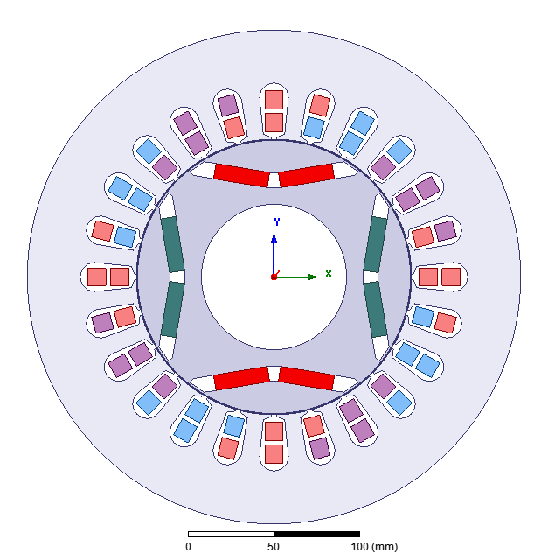
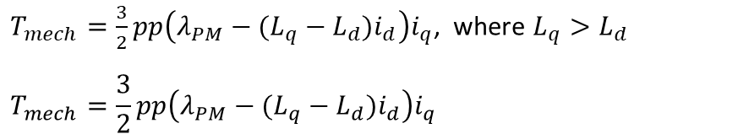
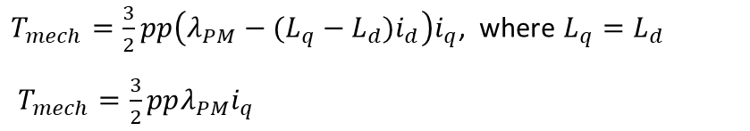
Torque in SMPMSM vs. IPMSM
SMPMSM
$T_{mech}=\frac{3}{2}pp\left(λ_{PM}−(L_{q}−L_{d})i_{d}\right)i_{q}$, where $L_{q}=L_{d}$
$T_{mech}=\frac{3}{2}ppλ_{PM}i_{q}$
➔ Only reactance (magnet) torque
IPMSM
$T_{mech}=\frac{3}{2}pp\left(λ_{PM}−(L_{q}−L_{d})i_{d}\right)i_{q}$, where $L_{q}>L_{d}$
$$T_{mech}=\frac{3}{2}pp\left(λ_{PM}−(L_{q}−L_{d})i_{d}\right)i_{q}$$
➔ Reactance (magnet) torque and reluctance torque

Slide 3
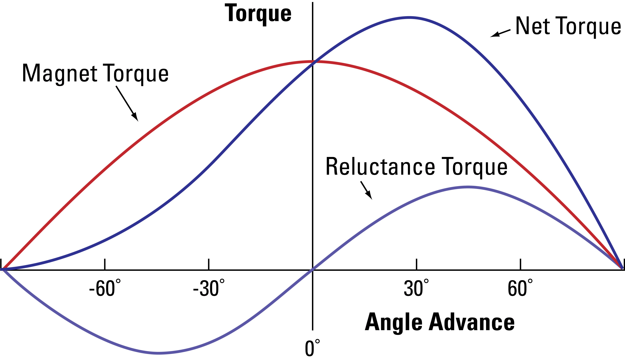
Torque in SMPMSM vs. IPMSM
SMPMSM
$T_{mech}=\frac{3}{2}p{p λ}_{PM}i_{q}$
➔ Only reactance (magnet) torque
IPMSM
$$T_{mech}=\frac{3}{2}pp\left(λ_{PM}−(L_{q}−L_{d})i_{d}\right)i_{q}$$
➔ Reactance (magnet) torque and reluctance torque
Net torque in IPMSM
Net torque in SMPMSM
d-axes: I_{q}=0
-d-axes: I_{q}=0
q-axes: I_{d}=0

Slide 4
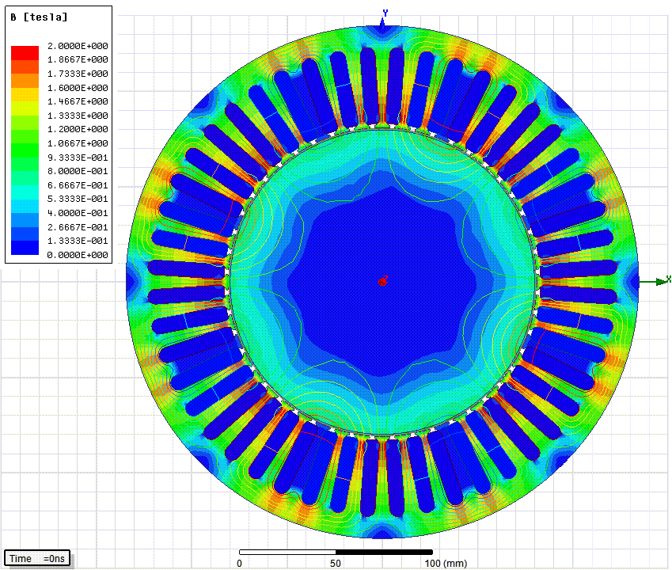
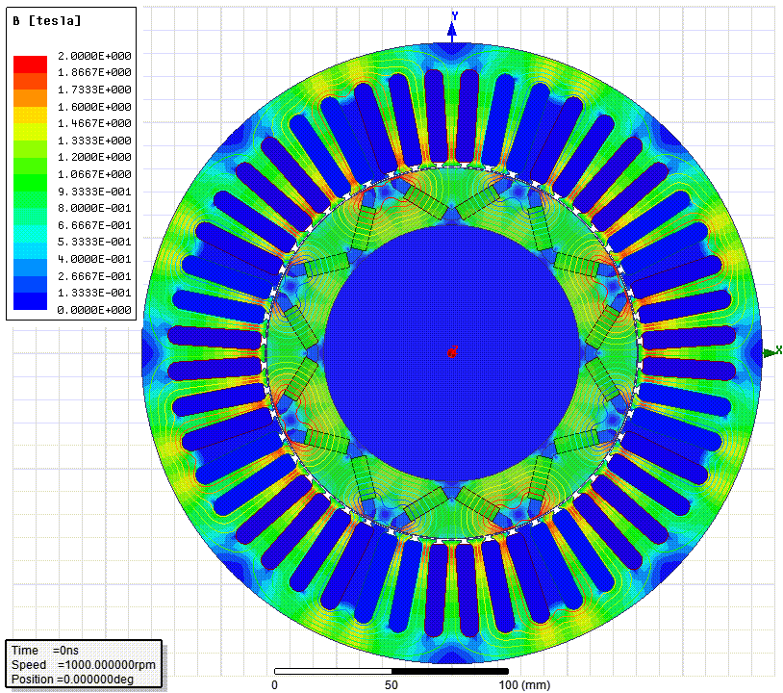
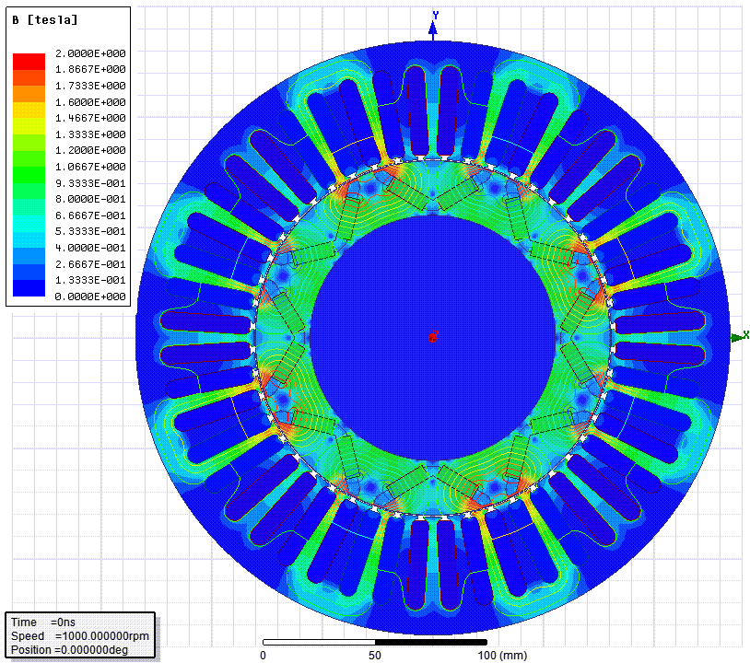
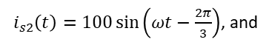
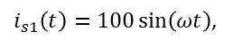
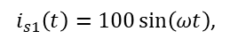
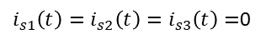
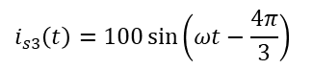
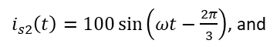
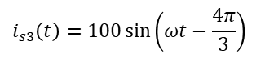
Simulation of an IPMSM
Stator rotating field & rotating rotor with PMs
Stator rotating field
Rotating rotor with PMs
$i_{s1}\left(t\right)=100\sin\left(ωt\right)$,
$i_{s1}\left(t\right)=i_{s2}\left(t\right)=i_{s3}\left(t\right)=$0
$i_{s1}\left(t\right)=100\sin\left(ωt\right)$,
$i_{s2}\left(t\right)=100\sin\left(ωt−\frac{2π}{3}\right)$, and
$i_{s2}\left(t\right)=100\sin\left(ωt−\frac{2π}{3}\right)$, and
$$i_{s3}\left(t\right)=100\sin\left(ωt−\frac{4π}{3}\right)$$
$$i_{s3}\left(t\right)=100\sin\left(ωt−\frac{4π}{3}\right)$$

Slide 5
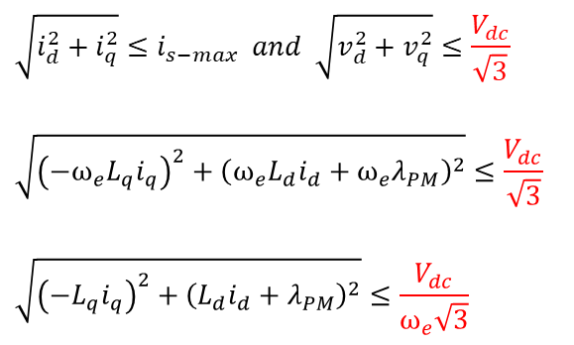
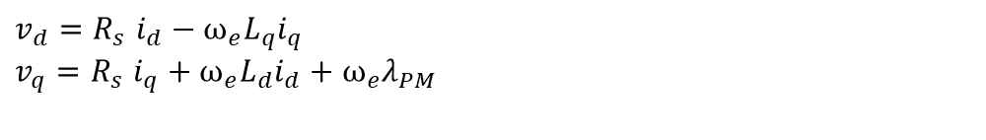
Limits in PMSM
Limiting Factors:
DC-link voltage
Current capability
Temperature (Cooling capability)
Current limit
$$v_{d}{=R}_{s}i_{d}−ω_{e}L_{q}i_{q}$$
$$v_{q}{=R}_{s}i_{q}+ω_{e}L_{d}i_{d}+ω_{e}λ_{PM}$$
$$\sqrt{i_{d}^{2}+i_{q}^{2}}≤i_{s−max} and \sqrt{v_{d}^{2}+v_{q}^{2}}≤\frac{V_{dc}}{\sqrt{3}}$$
$$\sqrt{{\left(−ω_{e}L_{q}i_{q}\right)}^{2}+{\left(ω_{e}L_{d}i_{d}+ω_{e}λ_{PM}\right)}^{2}}≤\frac{V_{dc}}{\sqrt{3}}$$
$$\sqrt{{\left(−L_{q}i_{q}\right)}^{2}+{\left(L_{d}i_{d}+λ_{PM}\right)}^{2}}≤\frac{V_{dc}}{ω_{e}\sqrt{3}}$$
Voltage limit
&
Current Limit
Torque in Nm
Power in kW
Rotational speed in rpm
Assumption: SV-PWM
http://ieeexplore.ieee.org/stamp/stamp.jsp?tp=&arnumber=6556123

Slide 6
BMW i3 EM Torque-Speed Characteristics
125 kW Machine
135 kW Machine
Torque in Nm
Torque in Nm
Rotational speed in rpm
Rotational speed in rpm

Slide 7
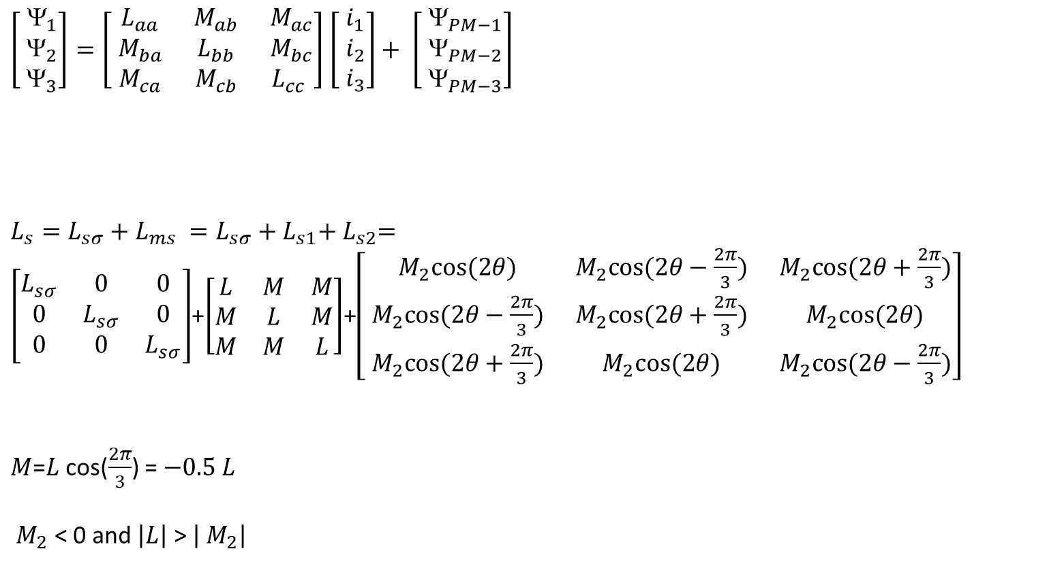
Self- and Mutual (Stator) Inductances
$\left[\begin{matrix}{ }_{1} \\ { }_{2} \\ { }_{3}\end{matrix}\right]=\left[\begin{matrix}{ L}_{aa} & { M}_{ab} & { M}_{ac} \\ { M}_{ba} & { L}_{bb} & { M}_{bc} \\ { M}_{ca} & { M}_{cb} & L_{cc}\end{matrix}\right]$ $\left[\begin{matrix}{ i}_{1} \\ { i}_{2} \\ { i}_{3}\end{matrix}\right]+ \left[\begin{matrix}{ }_{PM−1} \\ { }_{PM−2} \\ { }_{PM−3}\end{matrix}\right]$
$L_{s}={L_{sσ}+L}_{ms} ={L_{sσ}+L}_{s1}+{ L}_{s2}=\left[\begin{matrix}L_{sσ} & 0 & 0 \\ 0 & L_{sσ} & 0 \\ 0 & 0 & L_{sσ}\end{matrix}\right]$+$\left[\begin{matrix}L & M & M \\ M & L & M \\ M & M & L\end{matrix}\right]$+$\left[\begin{matrix}{ M}_{2}cos⁡(2θ) & { M}_{2}cos⁡(2θ−\frac{2π}{3}) & { M}_{2}cos⁡(2θ+\frac{2π}{3}) \\ { M}_{2}cos⁡(2θ−\frac{2π}{3}) & { M}_{2}cos⁡(2θ+\frac{2π}{3}) & { M}_{2}cos⁡(2θ) \\ { M}_{2}cos⁡(2θ+\frac{2π}{3}) & { M}_{2}cos⁡(2θ) & { M}_{2}cos⁡(2θ−\frac{2π}{3})\end{matrix}\right]$
$M$=$L$ cos($\frac{2π}{3}$) = $−0.5 L$
${ M}_{2}$ < 0 and $\left|L\right|$ > $\left|{ M}_{2}\right|$
$L_{s}$Inductance matrix: L self inductance and M mutual inductance
Leakage
Constant
Position dependent

Slide 8
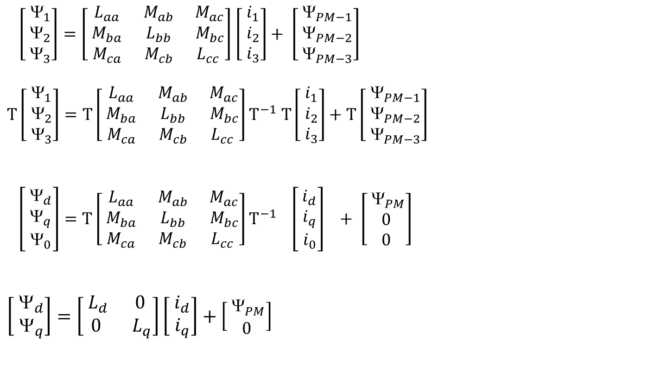
Self- and Mutual Inductances
$\left[\begin{matrix}{ }_{1} \\ { }_{2} \\ { }_{3}\end{matrix}\right]=\left[\begin{matrix}{ L}_{aa} & { M}_{ab} & { M}_{ac} \\ { M}_{ba} & { L}_{bb} & { M}_{bc} \\ { M}_{ca} & { M}_{cb} & L_{cc}\end{matrix}\right]$ $\left[\begin{matrix}{ i}_{1} \\ { i}_{2} \\ { i}_{3}\end{matrix}\right]+ \left[\begin{matrix}{ }_{PM−1} \\ { }_{PM−2} \\ { }_{PM−3}\end{matrix}\right]$
$$T\left[\begin{matrix}{ }_{1} \\ { }_{2} \\ { }_{3}\end{matrix}\right]=T\left[\begin{matrix}{ L}_{aa} & { M}_{ab} & { M}_{ac} \\ { M}_{ba} & { L}_{bb} & { M}_{bc} \\ { M}_{ca} & { M}_{cb} & L_{cc}\end{matrix}\right]T^{−1} T\left[\begin{matrix}{ i}_{1} \\ { i}_{2} \\ { i}_{3}\end{matrix}\right]+T\left[\begin{matrix}{ }_{PM−1} \\ { }_{PM−2} \\ { }_{PM−3}\end{matrix}\right]$$
$$\left[\begin{matrix}{ }_{d} \\ { }_{q} \\ { }_{0}\end{matrix}\right]=T\left[\begin{matrix}{ L}_{aa} & { M}_{ab} & { M}_{ac} \\ { M}_{ba} & { L}_{bb} & { M}_{bc} \\ { M}_{ca} & { M}_{cb} & L_{cc}\end{matrix}\right]T^{−1} \left[\begin{matrix}{ i}_{d} \\ { i}_{q} \\ { i}_{0}\end{matrix}\right] + \left[\begin{matrix}{ }_{PM} \\ 0 \\ 0\end{matrix}\right]$$
$$\left[\begin{aligned}{ }_{d} \\ { }_{q}\end{aligned}\right]=\left[\begin{matrix}{ L}_{d} & 0 \\ 0 & { L}_{q}\end{matrix}\right]\left[\begin{matrix}{ i}_{d} \\ { i}_{q}\end{matrix}\right]+\left[\begin{matrix}{ }_{PM} \\ 0\end{matrix}\right]$$
Inductances in dq coordinates
We assume that d and q axes are magnetically decoupled.

Slide 9
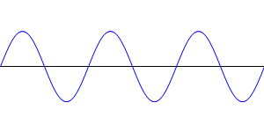
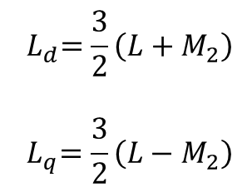
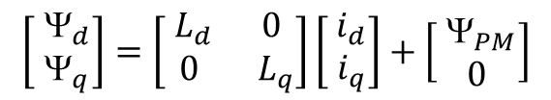
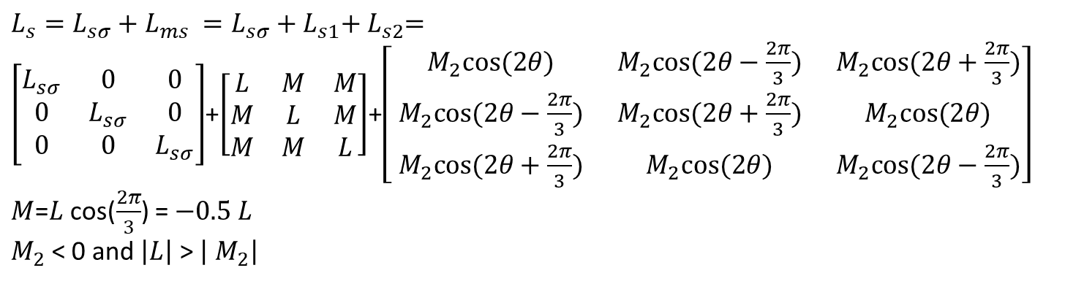
Self- and Mutual Inductances
$L_{s}={L_{sσ}+L}_{ms} ={L_{sσ}+L}_{s1}+{ L}_{s2}=\left[\begin{matrix}L_{sσ} & 0 & 0 \\ 0 & L_{sσ} & 0 \\ 0 & 0 & L_{sσ}\end{matrix}\right]$+$\left[\begin{matrix}L & M & M \\ M & L & M \\ M & M & L\end{matrix}\right]$+$\left[\begin{matrix}{ M}_{2}cos⁡(2θ) & { M}_{2}cos⁡(2θ−\frac{2π}{3}) & { M}_{2}cos⁡(2θ+\frac{2π}{3}) \\ { M}_{2}cos⁡(2θ−\frac{2π}{3}) & { M}_{2}cos⁡(2θ+\frac{2π}{3}) & { M}_{2}cos⁡(2θ) \\ { M}_{2}cos⁡(2θ+\frac{2π}{3}) & { M}_{2}cos⁡(2θ) & { M}_{2}cos⁡(2θ−\frac{2π}{3})\end{matrix}\right]$
$M$=$L$ cos($\frac{2π}{3}$) = $−0.5 L$
$M_{2}$ < 0 and $\left|L\right|$ > $\left|{ M}_{2}\right|$
$$\left[\begin{aligned}{ }_{d} \\ { }_{q}\end{aligned}\right]=\left[\begin{matrix}{ L}_{d} & 0 \\ 0 & { L}_{q}\end{matrix}\right]\left[\begin{matrix}{ i}_{d} \\ { i}_{q}\end{matrix}\right]+\left[\begin{matrix}{ }_{PM} \\ 0\end{matrix}\right]$$
$${ L}_{d}=\frac{3}{2}\left(L+M_{2}\right)$$
$${ L}_{q}=\frac{3}{2}\left(L−M_{2}\right)$$
3/2 (L-M₂)
3/2 L
3/2 L
3/2 (L+M₂)
d
q
-d
-q
d
q
-d
-q
SMPMSM
IPMSM

Slide 10
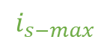
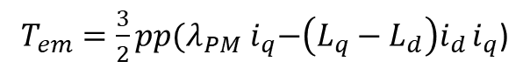
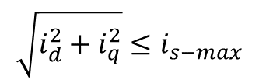
IPMSM Operation
Stator current limit:
Constant torque lines:
$$\sqrt{i_{d}^{2}+i_{q}^{2}}≤i_{s−max}$$
$T_{em}=\frac{3}{2}pp{(λ}_{PM}{ i}_{q}−\left(L_{q}−L_{d}\right)i_{d }i_{q}$)
q
Constant torque lines
MTPA line: Maximum Torque per Ampere
Constant stator current lines
$$i_{s−max}$$
d
MTPA: Maximum Torque per Ampere Control

Slide 11
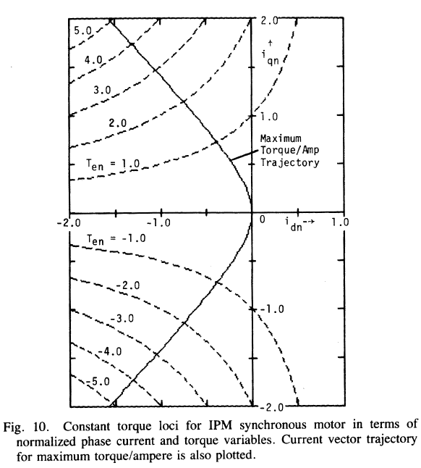
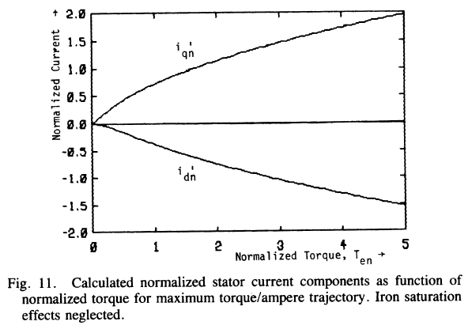
IPMSM Operation
Stator current limit:
$$\sqrt{i_{d}^{2}+i_{q}^{2}}≤i_{s−max}$$
T. M. Jahns, G. B. Kliman and T. W. Neumann, "Interior Permanent-Magnet Synchronous Motors for Adjustable-Speed Drives," in IEEE Transactions on Industry Applications, vol. IA-22, no. 4, pp. 738-747, July 1986

Slide 12
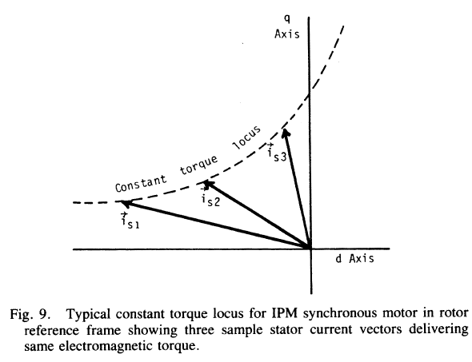
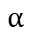
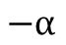
IPMSM Example
Vdc=450;
Vlim=Vdc/sqrt(3);
Flux_PM=0.222;
L_d= 250e-6;
L_q= 600e-6;
pp=3;
I_sc=Flux_PM/L_d;
I_phase=I_sc*0.8;
$$−α$$
$$α$$

Slide 13
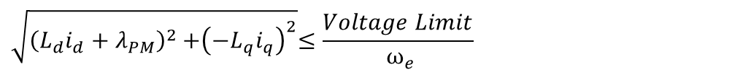
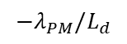
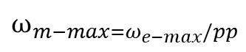
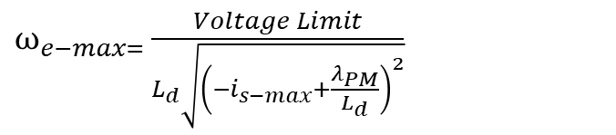
IPMSM Operation
Stator voltage limit:
$$\sqrt{{\left(L_{d}i_{d}+λ_{PM}\right)}^{2}{+\left(−L_{q}i_{q}\right)}^{2}}≤\frac{Voltage Limit}{ ω_{e}}$$
Stator Flux
q
MTPF line: Maximum Torque per Flux
$ω_{e−max=}\frac{Voltage Limit}{L_{d}\sqrt{{\left(−i_{s−max}+\frac{λ_{PM}}{L_{d}}\right)}^{2}}}$
Constant stator flux lines
$$ω_{m−max=ω_{e−max}/pp}$$
As speed increase, the operation is limited by inner flux limits.
$$−λ_{PM}/L_{d}$$
d

Slide 14
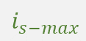
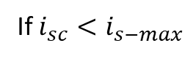
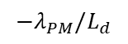
IPMSM Operation
Operating current trajectories:
Short-circuit current (characteristic current):
If $i_{sc}<i_{s−max}$
q
$$i_{s−max}$$
MTPA
MTPF
$$−λ_{PM}/L_{d}$$
d
Constant stator flux lines

Slide 15
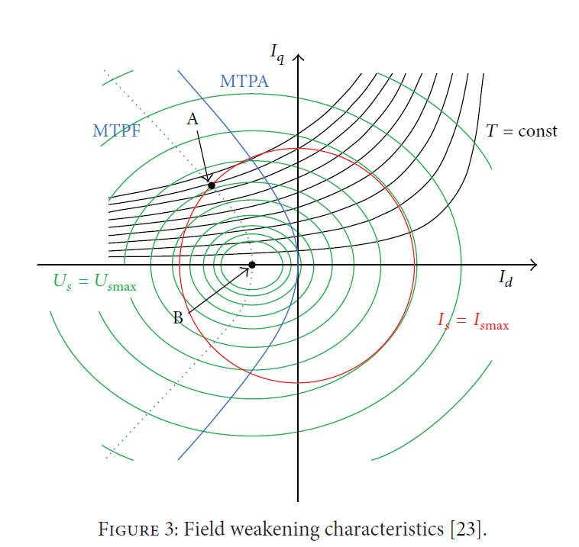
IPMSM Operation
Toosi, Saman & Mehrjou, Mohammad & Karami, Mahdi & Zare, Mohammad Reza. (2013). Increase Performance of IPMSM by Combination of Maximum Torque per Ampere and Flux-Weakening Methods. ISRN Power Engineering. 2013. 10.1155/2013/187686.

Slide 16
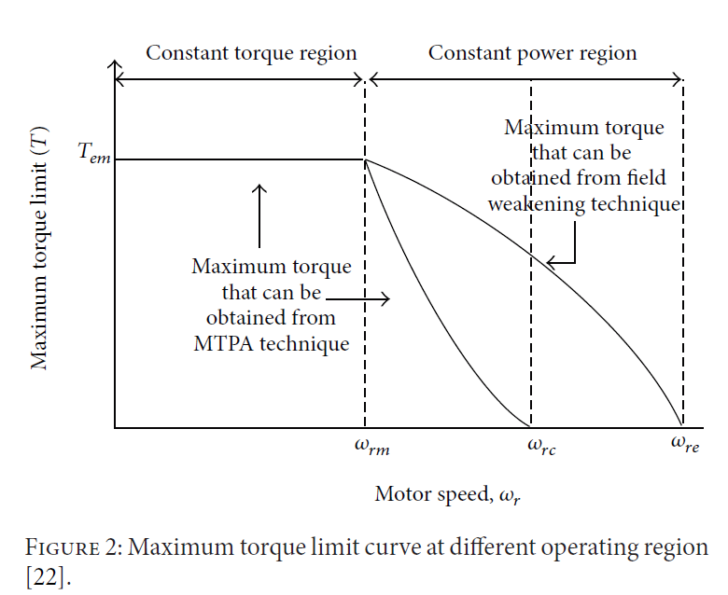
IPMSM Operation
Toosi, Saman & Mehrjou, Mohammad & Karami, Mahdi & Zare, Mohammad Reza. (2013). Increase Performance of IPMSM by Combination of Maximum Torque per Ampere and Flux-Weakening Methods. ISRN Power Engineering. 2013.

